Slide 1
TASK 3
Finding Vulnerabilities on website

Slide 2
REPORT
In this task we need to find Vulnerabilities on website.
And the website was created with the goal of putting the Acunetix Web Vulnerability Scanner to the test.
As a result, this website has a large number of defects in order to illustrate the software's ability to detect them.
It gives the attacker the ability to aggregate the results of two or more SELECT commands into a single result.
It is an automated web application security testing tool that examines your online applications for vulnerabilities such as SQL Injection, Cross-Site Scripting, and other exploitable flaws.

Slide 3
CROSS SITE SCRIPTING(XSS)
Vulnerability Report on SQL INJECTION
The Vulnerability test was done on the domain Vulnweb.com
●Subdomain was http://testasp.vulnweb.com/
●Cross Site Scripting Vulnerability was found on the site
Cross-site scripting (XSS) is a type of security vulnerability that can be found in some web applications. XSS attacks enable attackers to inject client-side scripts into web pages viewed by other users. A cross-site scripting vulnerability may be used by attackers to bypass access controls such as the same-origin policy.
SQL injection, also known as SQLI, is a common attack vector that uses malicious SQL code for backend database manipulation to access information that was not intended to be displayed. This information may include any number of items, including sensitive company data, user lists or private customer details.

Slide 4
STEPS TO FIND THE VULNERABILITY
Open Burp Suite Check Whether The Intercept Is On.
Open Firefox And Search For Vulnweb.
Click On Http://testasp.vulnweb.com The Given Interface Will Be Opened
Click On Search Bar And Click The Foxyproxy On
Try To Enter One Of The Payloads So The Request Will Be Sent To Burpsuite
After The Request Comes Send It To Intruder And Forward The Request
Add The Payload Position Only For The Required Place
Add The Xss Payloads ,which Can Be Downloaded From Www.github.com
Start The Attack And Check Whether There Is Sudden Change In Length And Status.
Copy The Url To Show The Response For The Paylod That Has Been Accepted
Copy The Url And Search It In Firefox
The Required Interface Will Be In This Form.

Slide 5
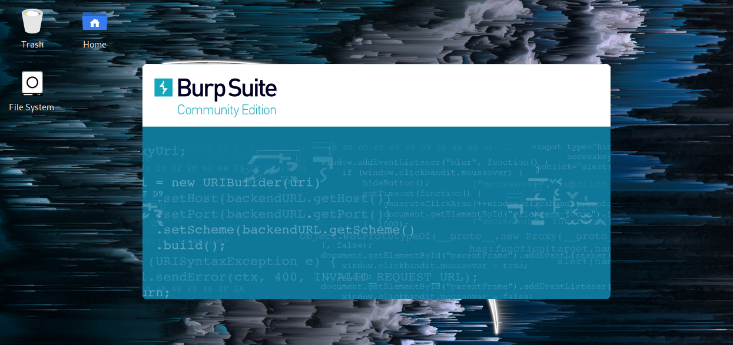

Slide 6
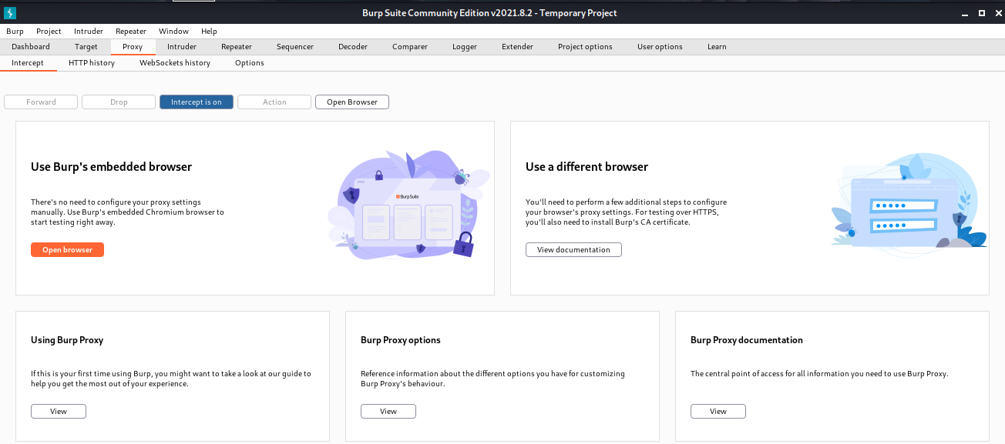

Slide 7
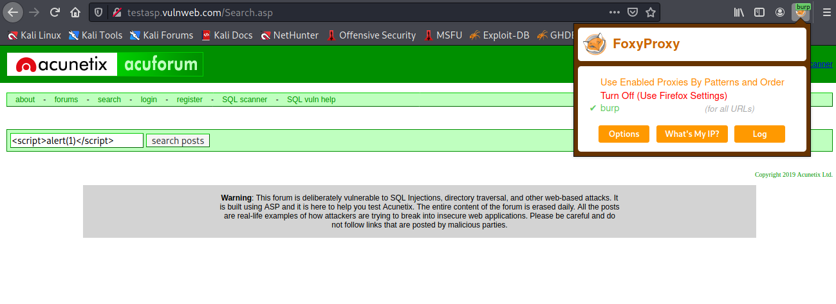

Slide 8
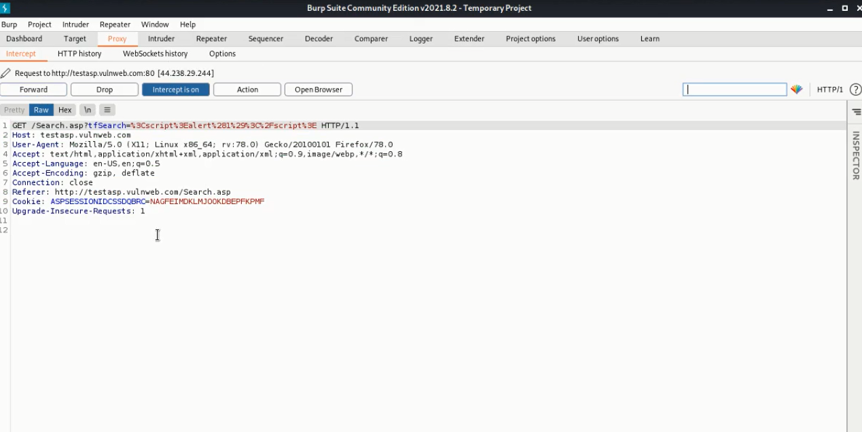

Slide 9
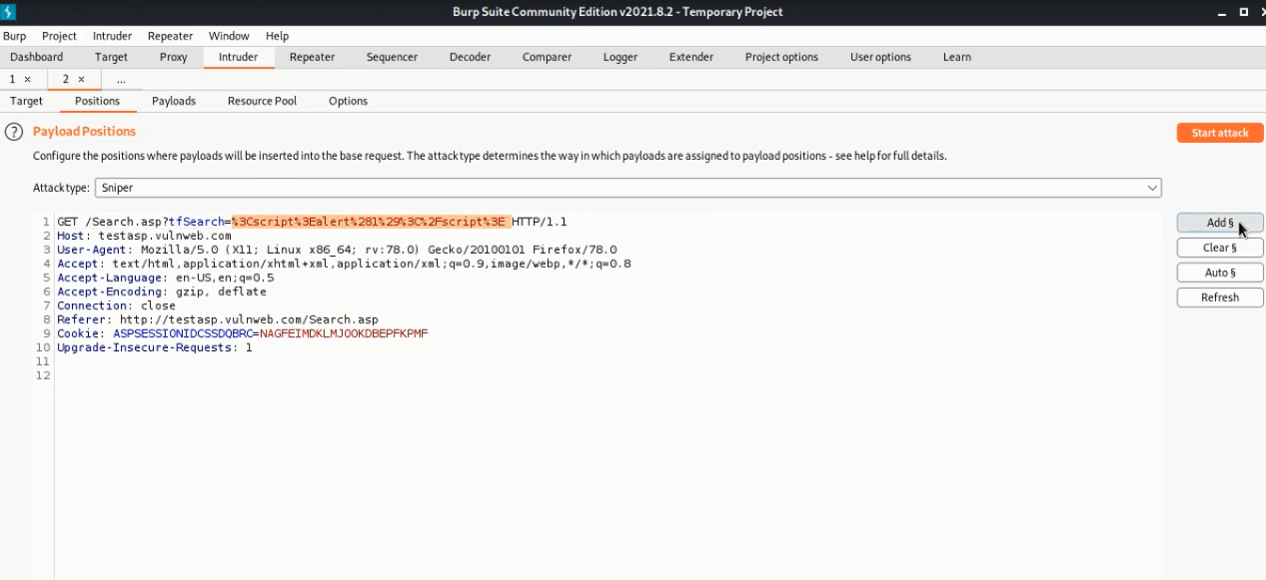

Slide 10
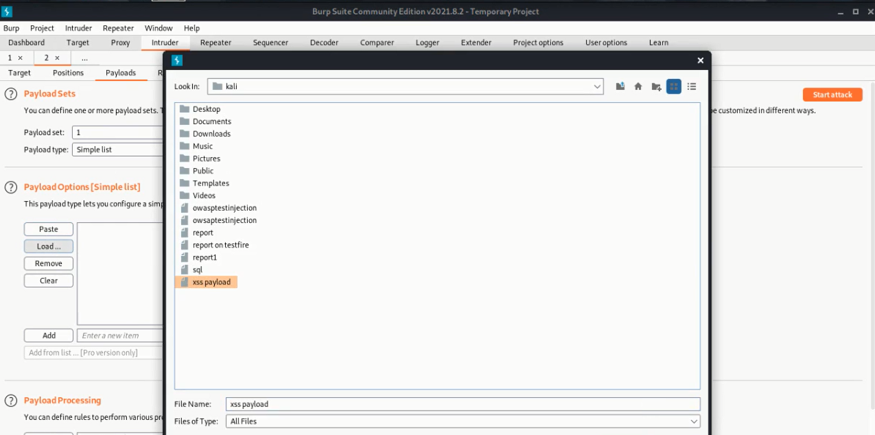

Slide 11
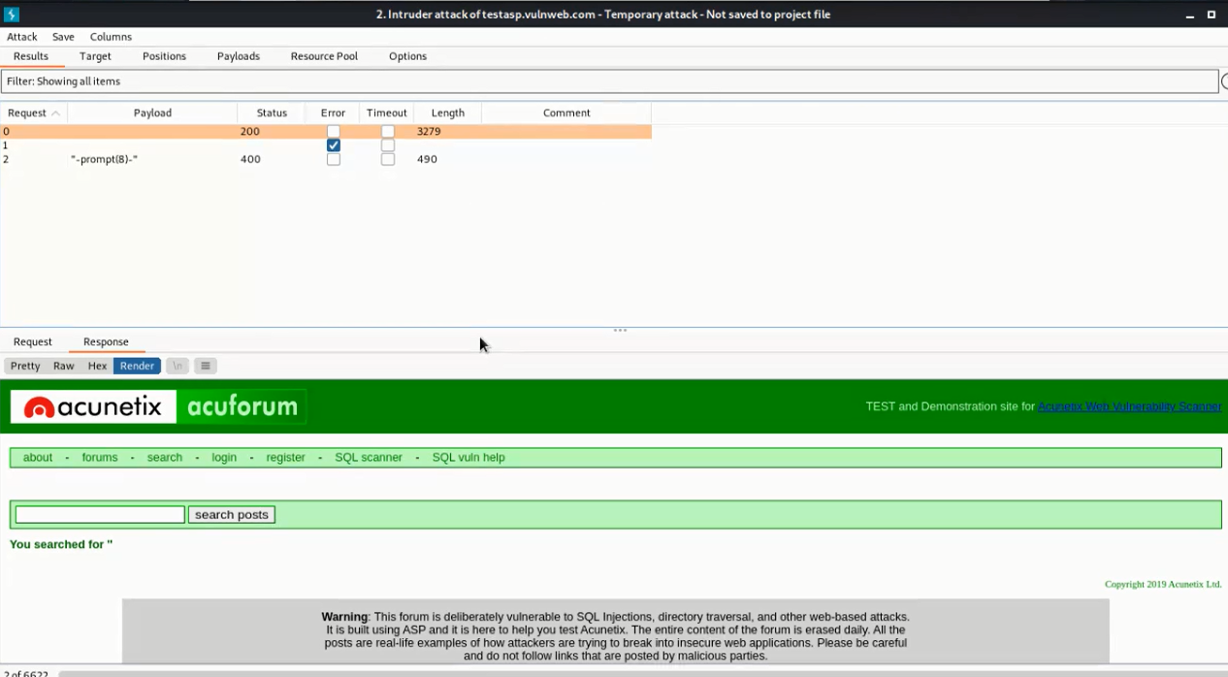

Slide 12
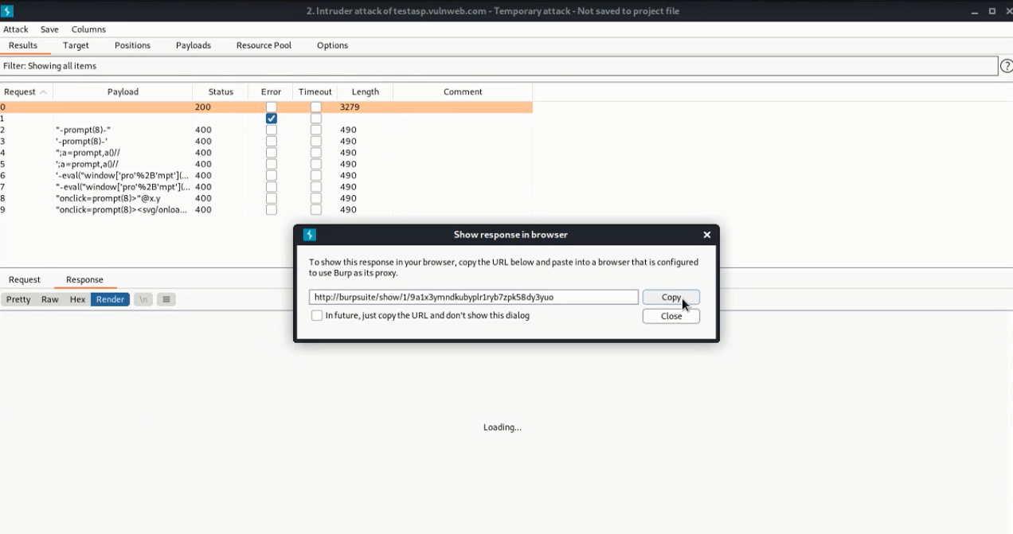

Slide 13
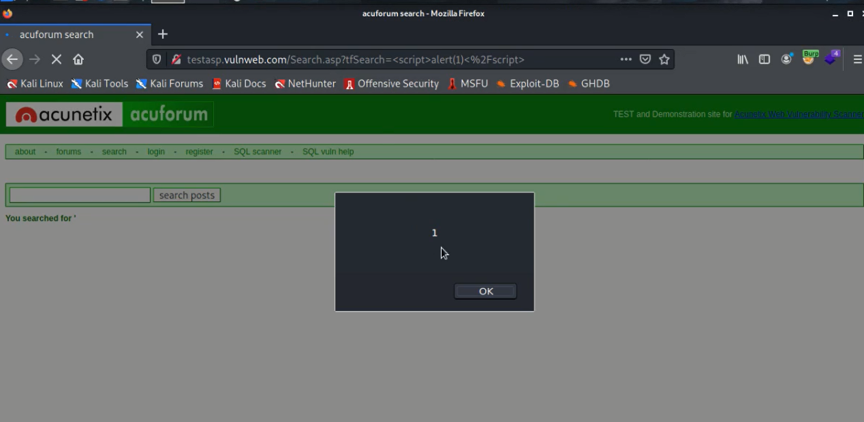

Slide 14
Impact: -
SQL Injections often let an attacker obtain access to customer records, personally identifiable information (PII), and other confidential data. A successful attack may result in the unauthorized viewing of user lists, the deletion of entire tables and, in certain cases, the attacker gaining administrative rights to a database, all of which are highly detrimental to a business.
Recommendation: -
The only sure way to prevent SQL Injection attacks is input validation and parameterized queries including prepared statements. The application code should never use the input directly. The developer must sanitize all input, not only web form inputs such as login forms.

